Slide 1
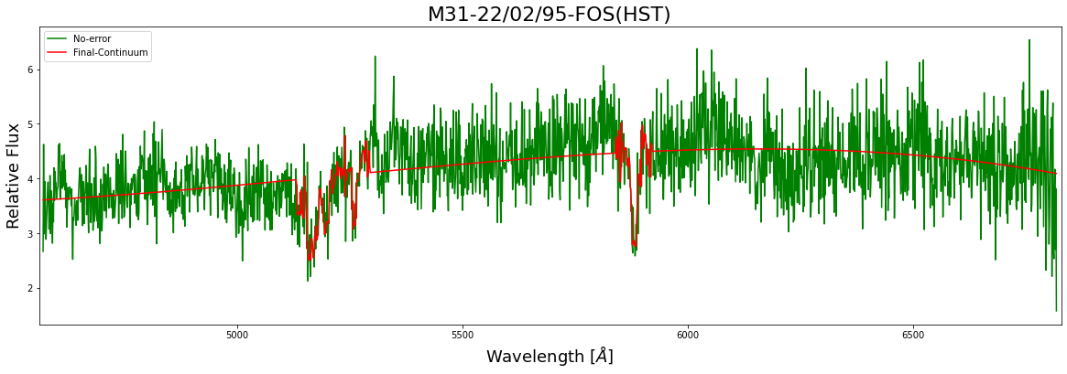
M31 Spectra Analysis
Rohan Kumar
Notes:
Have to write script

Slide 2


About My Project
Spectral Data from the central region of M31 was analyzed and fitted
Absorption Lines were also identified
SciPy suite and AstroPy were used for reduction and analysis of the data

Slide 3
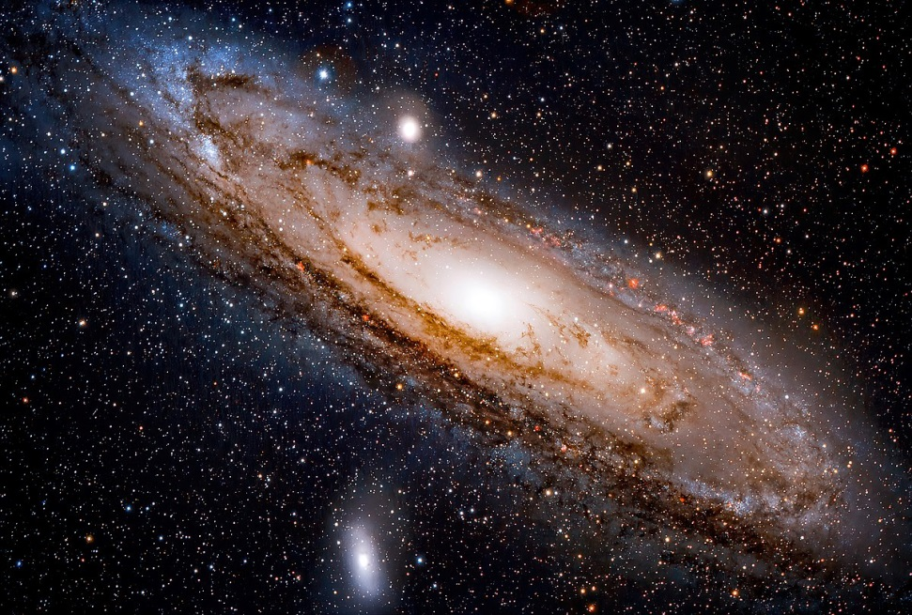
What is M31?
Type: Spiral Galaxy(Sa(s)b)
Distance from Earth: 2.53Mly
Age: 10.01 billion years

Slide 4
Where is Data from?

Slide 5
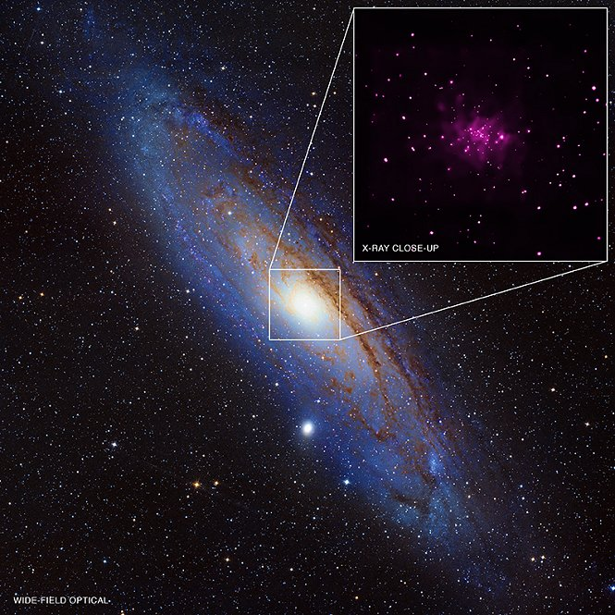
Location: Galactic Centre of Andromeda

Slide 6
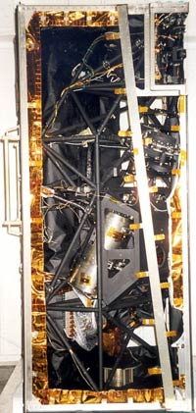
About Dataset
Instrument: FOS(HST)
Wavelength: 4569.102 Å-6817.517Å
Date-OBS: 22/02/95
Time-OBS: 06:20:49

Slide 7
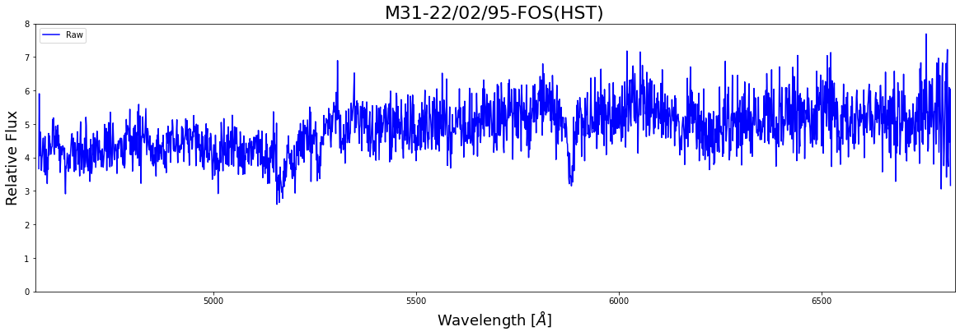
What does raw data looks like

Slide 8
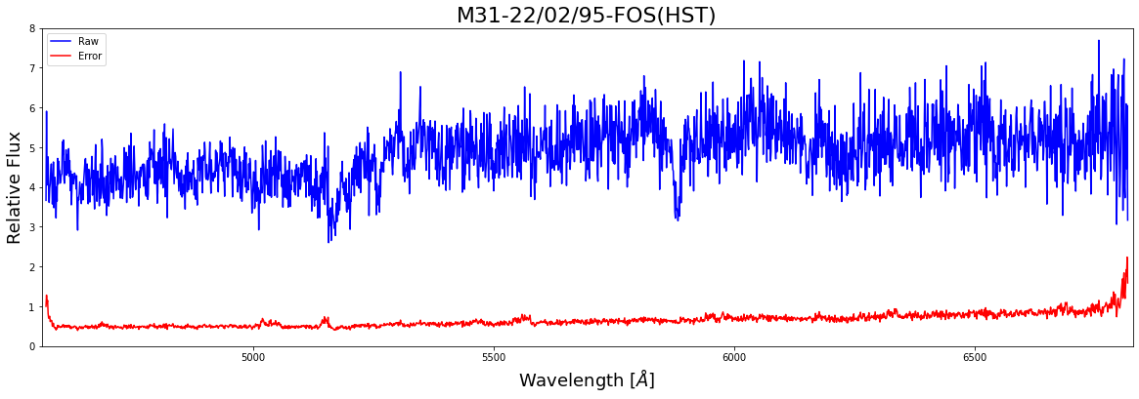
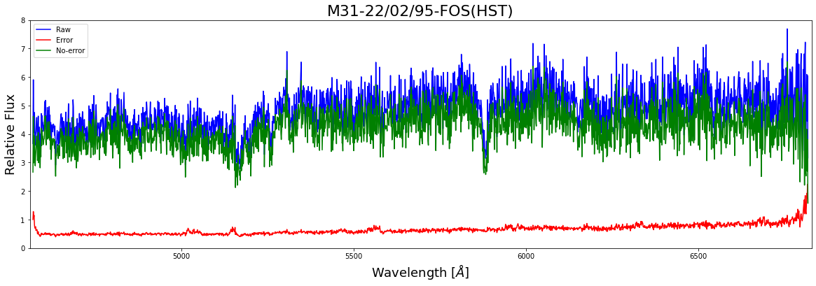
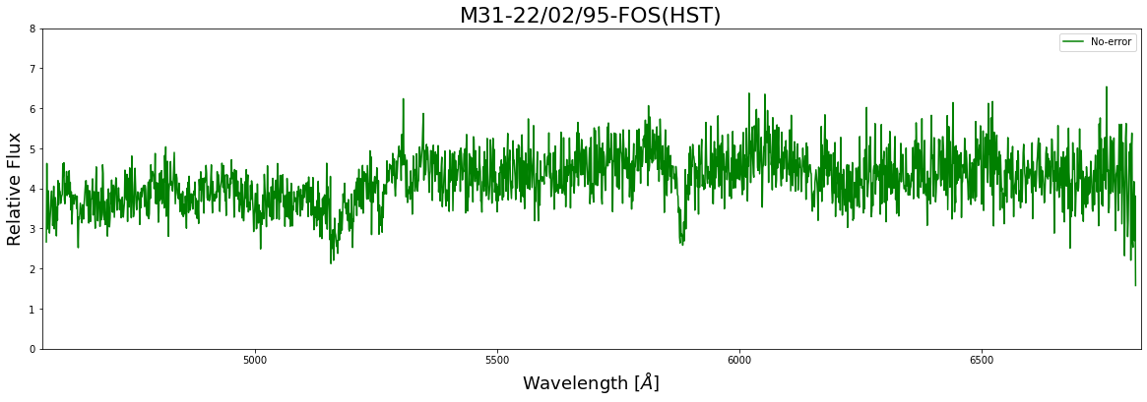
Removing the Error

Slide 9
Raw Data
No Error

Slide 10
Spectrum Fitting Process

Slide 11

Continuum Fit

Slide 12
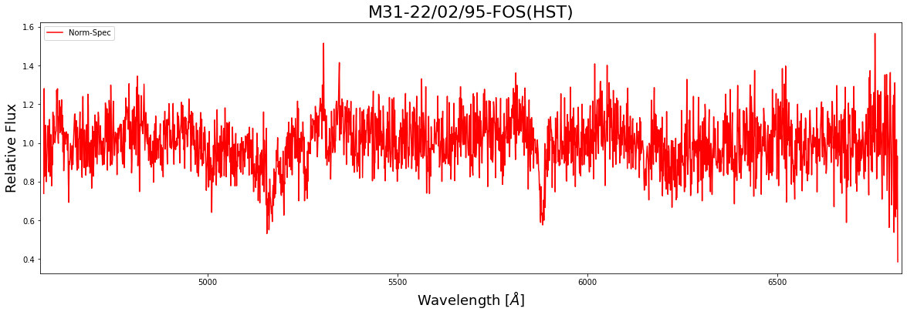
Normalized Spectra

Slide 13
Identifying and Modeling the Spectral lines

Slide 14
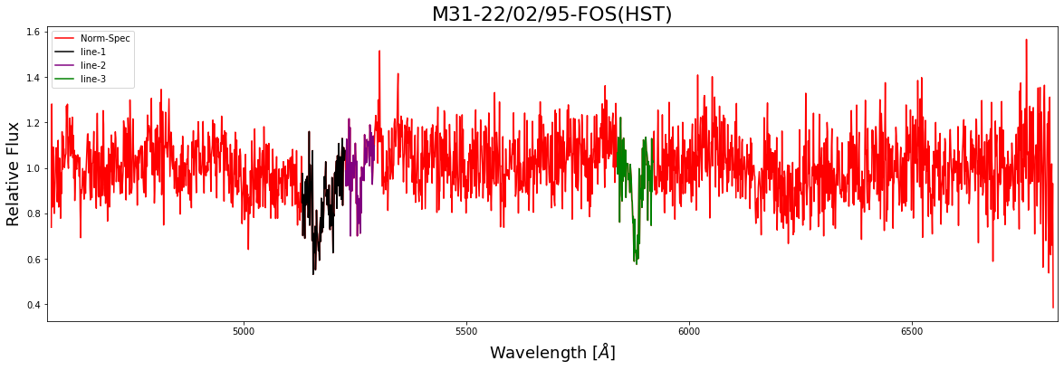
Identification of Absorption lines
Identification was done manually

Slide 15
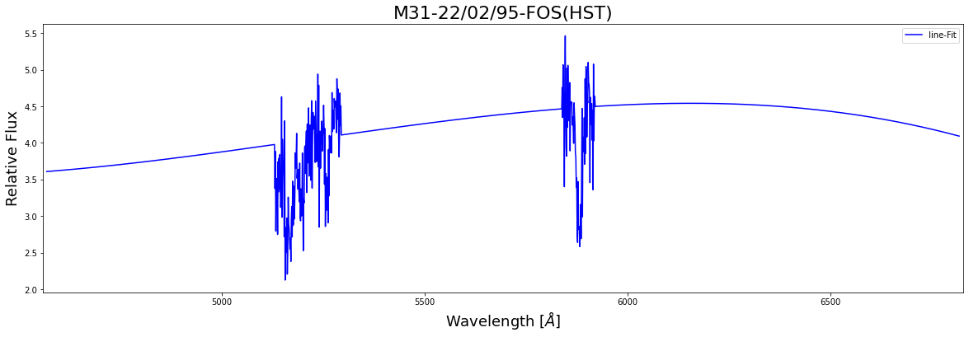
How was Line Fitting done?
Absorption lines were Superimposed on the continuum fit

Slide 16
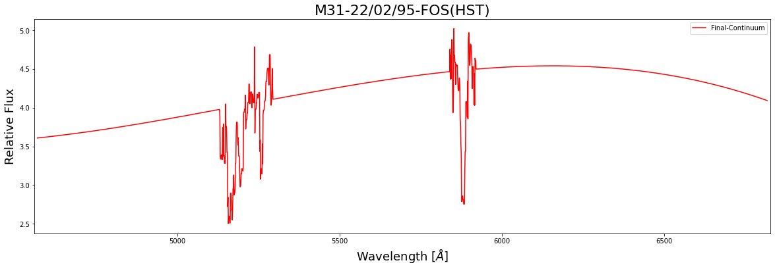
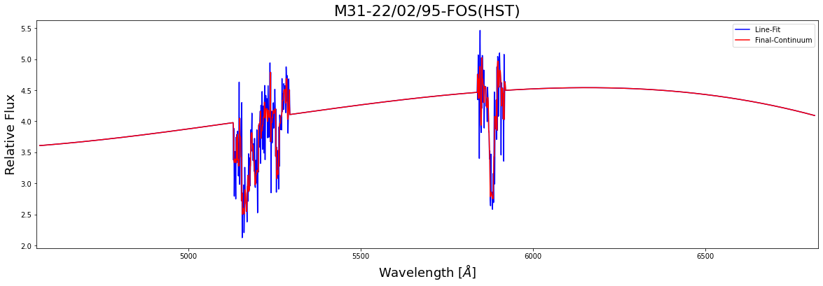
Smoothing of the Continuum
The Spectra was passed through 1D-median-filter to smooth it out

Slide 17
Comparison of Final Continuum with the Original Spectra

Slide 19
Original Spectra
Final Continuum

Slide 20
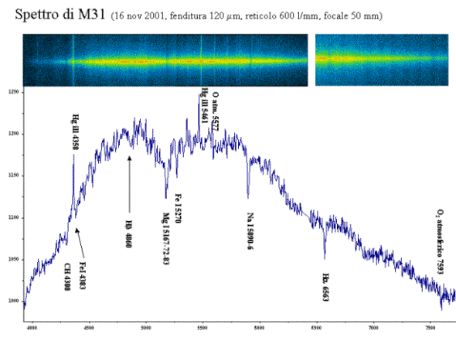

Slide 21
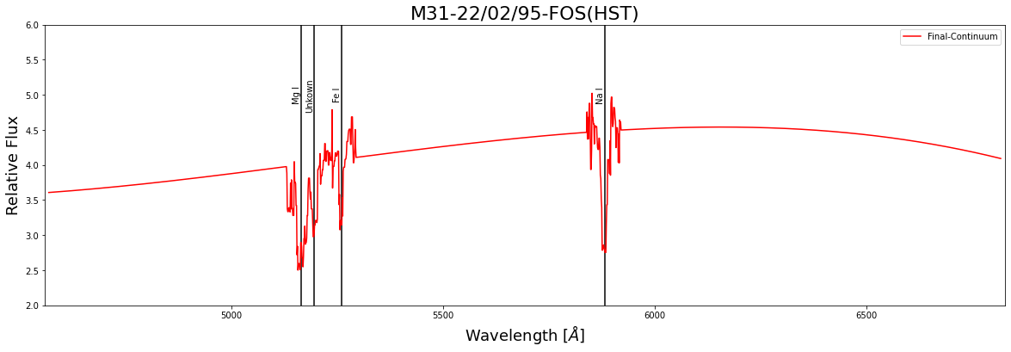
Element Finding
4 Elements were found
1 of the Element is unidentified
Notes:
3 absorbtion lines were associated

Slide 22
Conclusion
3 elements were identified in the region
Mg I[5165Å]
Fe I[5261Å]
Na I[5881Å]
1 unknown line was also found

Slide 23
Thank You

